Slide 1
Predicting the impact of a new infectious disease based on the basic reproduction number is challenging
Exploration using simulations with a simple model
C. Bartels, May 2020
Available at: https://doi.org/10.6084/m9.figshare.12116571
Code available at: https://doi.org/10.6084/m9.figshare.12115833

Slide 2

Predicting the impact of an infectious disease is challenging
The final impact of a new infectious disease is related to the herd immunity threshold
For random vaccination, the initial growth rate (basic reproduction number), $R_{0}$, is related to the herd immunity threshold $1−1/{R_{0}}$ (Refs 1, 2, 5, 9)
For natural transmission of a new infectious disease, this simple relationship may break down (Refs 4, 7, 8)
Here: simulations of natural transmission
using $R_{0}=2.4$ and a simple model (simplistic version of Refs 3, 6)
Investigating dependence on population heterogeneity and interventions such a social distancing
Conclusion: $R_{0}$ alone has limited value for predicting impact, with $R_{0}=2.4$, final impact varied between 20% and 80%
Limitations:
All models and simulations remain simplistic relative to potential realities and more extreme results might be possible
Information beyond $R_{0}$ might be used to obtain more reliable predictions

Slide 3
References
Altmann, D.M., Douek, D.C. and Boyton, R.J., 2020. What policy makers need to know about COVID-19 protective immunity. The Lancet.
Cobey, S., 2020. Modeling infectious disease dynamics. Science.
Dottori, M. and Fabricius, G., 2015. SIR model on a dynamical network and the endemic state of an infectious disease. Physica A: Statistical Mechanics and its Applications, 434, pp.25-35.
Fine, P., Eames, K. and Heymann, D.L., 2011. “Herd immunity”: a rough guide. Clinical infectious diseases, 52(7), pp.911-916.
Heesterbeek, H., Anderson, R.M., Andreasen, V., Bansal, S., De Angelis, D., Dye, C., Eames, K.T., Edmunds, W.J., Frost, S.D., Funk, S. and Hollingsworth, T.D., 2015. Modeling infectious disease dynamics in the complex landscape of global health. Science, 347(6227), p.aaa4339.
McGee, R., 2020. Models of SEIRS epidemic dynamics with extensions, including network-structured populations, testing, contact tracing, and social distancing. https://github.com/ryansmcgee/seirsplus (accessed 3 April 2020)
Metcalf, C.J.E., Ferrari, M., Graham, A.L. and Grenfell, B.T., 2015. Understanding herd immunity. Trends in immunology, 36(12), pp.753-755.
Miller, J.C., 2012. A note on the derivation of epidemic final sizes. Bulletin of mathematical biology, 74(9), pp.2125-2141.
Randolph., H.E., Barreiro, L.B. 2020. Herd immunity: Understanding COVID-19. DOI: 10.1016/j.immuni.2020.04.012

Slide 4
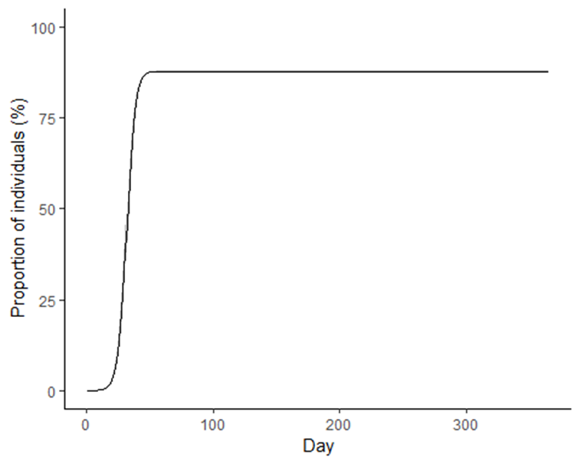

Spread of an infection within a population
Evolution of an infection:
Final impact, infection did stop spreading
For random vaccination and simple models of the spread
Initial growth rate (basic reproduction number), $R_{0}$, is related to the herd immunity threshold $1−1/{R_{0}}$.
Impact:
For random vaccination: Impact is equal to herd immunity threshold
For uncontrolled spread: final impact will exceed threshold
Herd immunity threshold: the number of infected individuals that transmit the disease starts to decrease
Initial exponential growth of the number of individuals who were infected

Slide 5
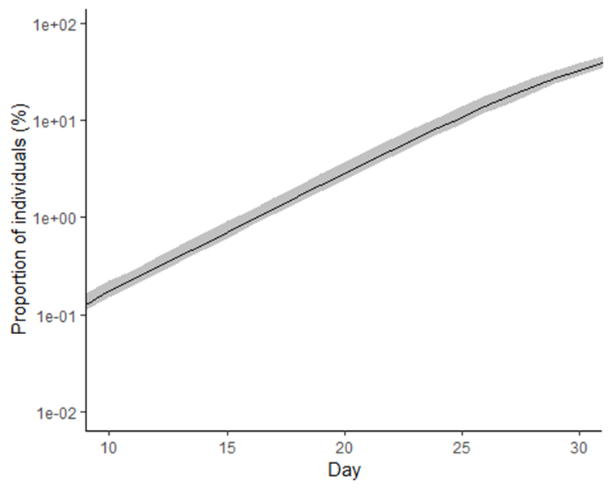

Simple model
Initial exponential growth of the number of people who were infected
Individuals get infected
During a certain time period (here 6 days), an infected individual can infect other individuals
New infection happen
At given daily rate: 0.4 Day⁻¹
Only naïve persons that had no infection yet can be infected
Corresponds to
$R_{0}=0.4 {Day}^{−1}×6Day=2.4$
Vaccination (herd immunity) threshold at which 1 person infects 1 uninfected person: 1 – 1 / 2.4 = 58% infected

Slide 6
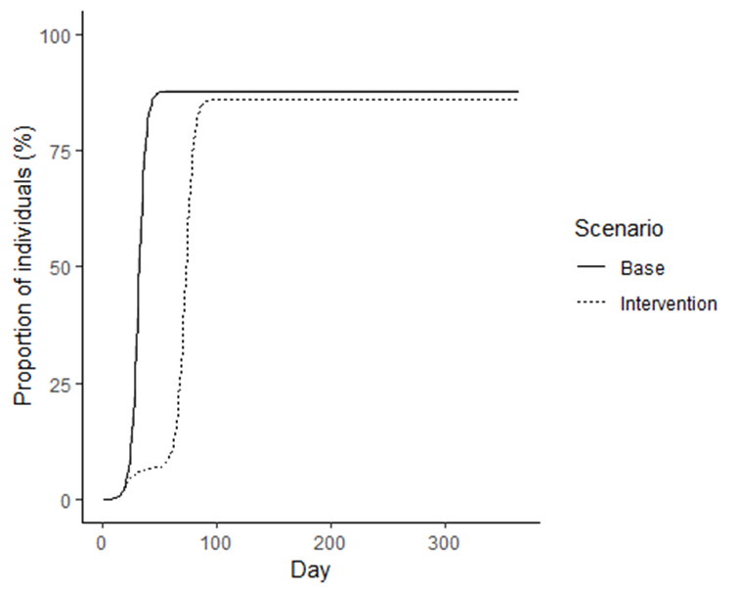
Short intervention does not change herd immunity
Social distancing for one month
Similar impact, independent of intervention
Example intervention:
Social distancing from day 20 to 50 that reduces infection rate by 70% during this period
Rate back to normal after intervention
“Overshooting” above 58% vaccination threshold due to rapid kinetics
Careful prolonged intervention schemes could reduce impact down to the 58% threshold (not shown)
At end of intervention, infection resumes
Social distancing stops spread

Slide 7
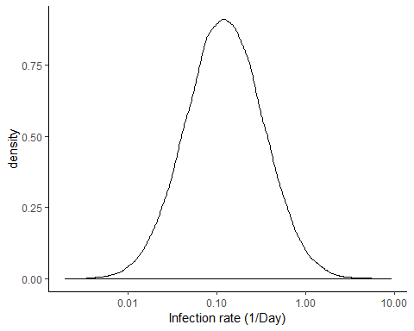
Population heterogeneity
Distribution of infection rate:
People are different
Some have many contacts and will spread infection rapidly
Others have few contacts and spread infection slowly
→ Assume population in which each subject has its own rate of being infected and of infecting others

Slide 8
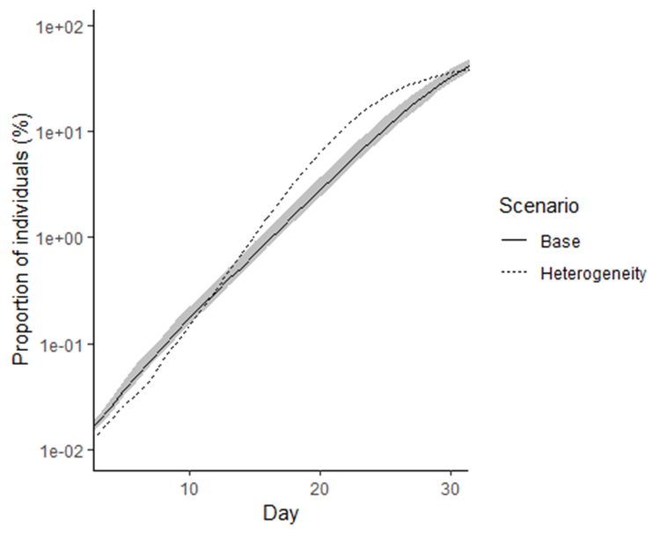
Similar initial evolution independent of heterogeneity
Heterogeneous population selected to have comparable initial rate as homogenous population
Initial “exponential” evolution of an infection can be similar independent of heterogeneity

Slide 9
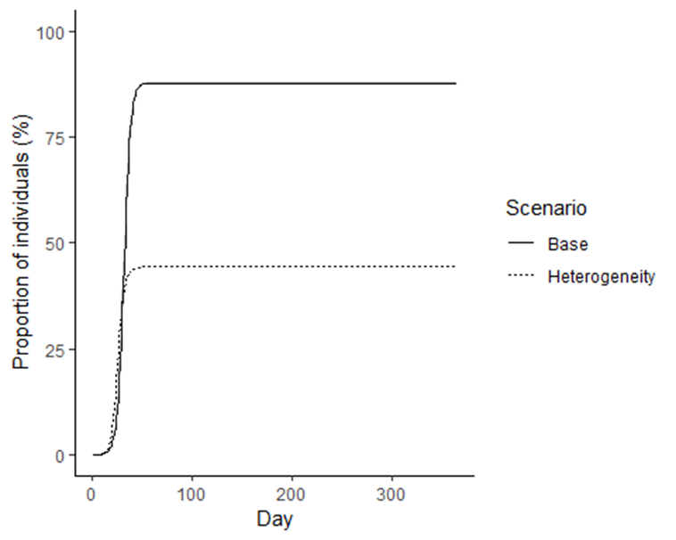
Final impact depends on heterogeneity
Two simulations
Base … homogeneous infection rate
Heterogeneity … heterogenous infection rate with comparable initial rate
Also, vaccination (herd immunity) threshold at which one person infects one uninfected person changes
Base scenario: threshold is at 58%
Heterogeneity: threshold lies below 58%, in general

Slide 10
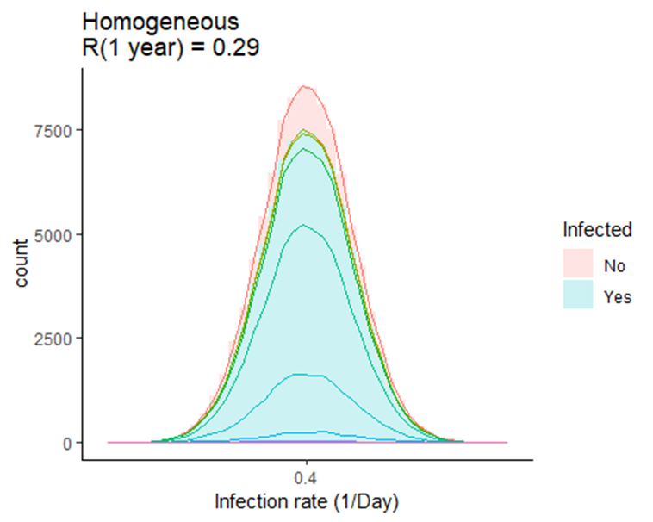
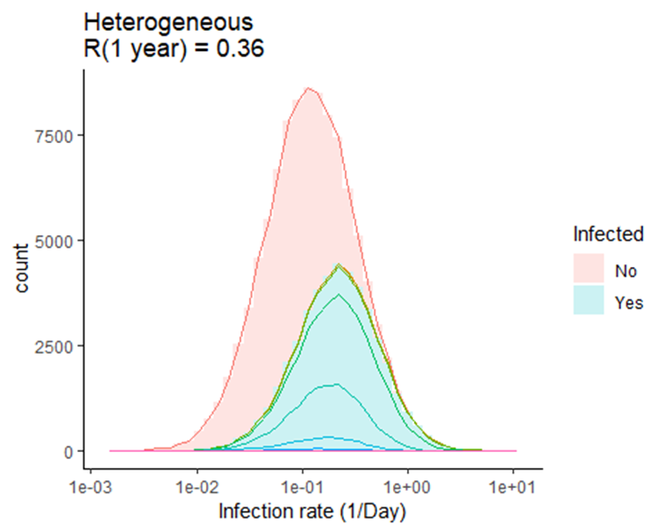
«infectious» individuals contribute more to establishing herd immunity
Heterogeneous population: individuals with a high infection rate get infected first
They have high propensity of being infected and of infecting others
They contribute most to average transmission in the population
Once they are immune, the spread stops
Lines within infected population illustrate progression (1 week per line)

Slide 11
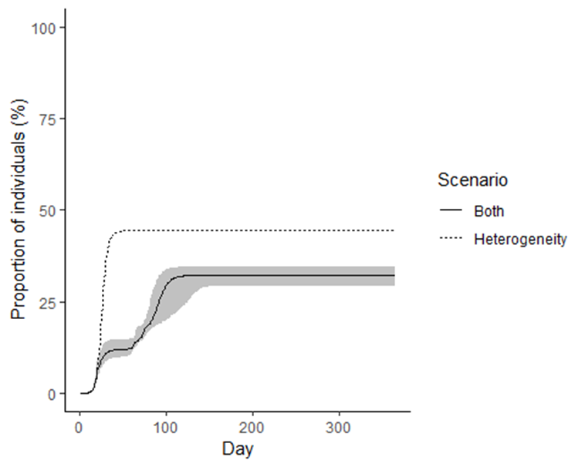
Intervention can change final impact
Two simulations with heterogeneous population
Heterogeneity … no intervention
Both … intervention reducing rate by 70% between days 20 and 50
Interventions change the kinetics od the spread including the overshoot
In addition, population and the distribution of the rate of infection may changes
As disease progresses
As a function of potential interventions
Different distribution of rates
Different kinetics of spread
Different final impact
Grey band indicates uncertainty: 25% to 75% percentile of repeated simulations

Slide 12
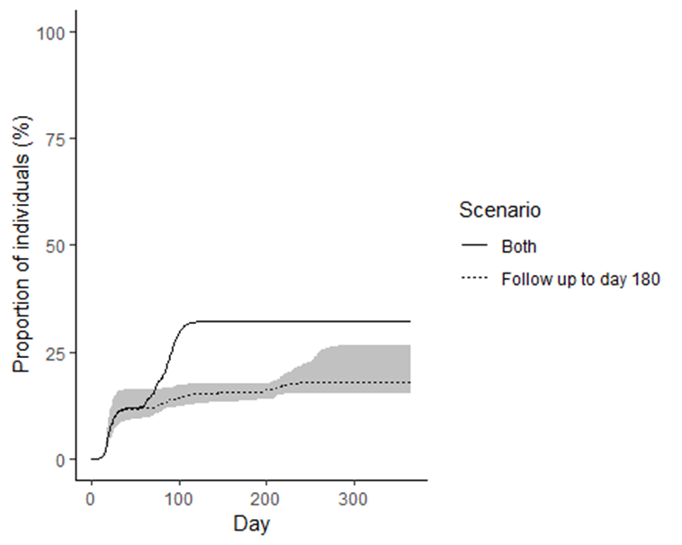
Many different scenarios give different levels of herd immunity
Two simulations with heterogeneous population
Both … intervention reducing rate by 70% between days 20 and 50
Follow up to day 180 … intervention reducing rate by 70% between days 20 and 50 and by 40% up to day 180
Scenarios depend on
Underlying factors that cannot be influenced (properties of population and disease)
Interventions
All scenarios are simplistic relative to potential realities
Grey band indicates uncertainty: 25% to 75% percentile of repeated simulations

Slide 13
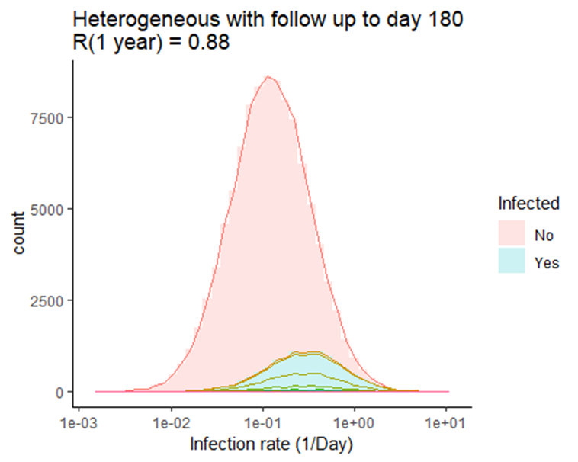
Interventions reduce overshooting due to rapid kinetics
No intervention: overshooting, R(1 year) is below 1
Interventions can bring R(1 year) closer to 1 This corresponds to a reduction of the final impact
Lines within infected population illustrate progression (1 week per line)

Slide 14
Predicting the impact of an infectious disease is challenging
The final impact of a new infectious disease is related to the herd immunity threshold
For random vaccination, the initial growth rate (basic reproduction number), $R_{0}$, is related to the herd immunity threshold $1−1/{R_{0}}$ (Refs 1, 2, 5, 9)
For natural transmission of a new infectious disease, this simple relationship may break down (Refs 4, 7, 8)
Here: simulations of natural transmission
using $R_{0}=2.4$ and a simple model (simplistic version of Refs 3, 6)
Investigating dependence on population heterogeneity and interventions such a social distancing
Conclusion: $R_{0}$ alone has limited value for predicting impact, with $R_{0}=2.4$, final impact varied between 20% and 80%
Limitations:
All models and simulations remain simplistic relative to potential realities and more extreme results might be possible
Information beyond $R_{0}$ might be used to obtain more reliable predictions

